Slide 1
Chapter 11 Object-Oriented and Event-Driven Programming

Slide 2
11.1 Classes and Objects
An object is a structure composed of:
data (or attributes)
processes (or methods) that perform operations on that data.
Object-oriented programming is often referred to as OOP
OOP is an approach to program design and coding that emphasizes:
the objects needed to solve a given problem
and the relationships among them

Slide 3
The Clock Class
The fundamental entity in object-oriented programming is the class.
A class is a data type that:
allows us to create objects
provides the definition for a collection of objects by:
describing its attributes (data)
specifying the methods (operations) that may be applied to that data

Slide 4
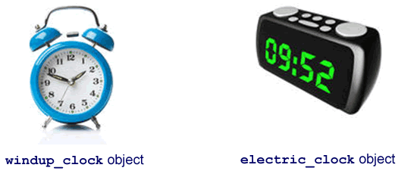
Classes
The alarm_clock class describes
what an alarm_clock is and
what can be done with it.
An alarm clock object
is a particular example of
an alarm_clock.

Slide 5
The Class as a Data Type
A primitive data type is predefined by the programming language.
It is named by a reserved keyword, like Integer, Float, or Character.
A class is a data type that the programmer creates.
The purpose of defining a class is to allow us to create objects.
An object is just a particular instance of its class.

Slide 6
An Instance of an Object or a Data Type
An object is just a particular instance of its class
The relationship between a class and its objects is like the relationship between a data type and variables of that type
Example: Declare Number As Integer
states what kind of data we are dealing with
what operations (+, –, and so forth) can be performed on it
the variable Number is a particular instance of the type Integer
Difference between a primitive data type and a class:
programmer creates the class and defines the attributes and methods associated with that class
a primitive data type is defined in the programming language

Slide 7
Objects
Objects are made up of two components:
data (attributes)
operations on that data (methods)
We say that an object encapsulates data and operations
an object is like a little package containing both the data and operations about that particular object
the operations are specified in the class definition
the data are specific to the particular object under consideration
the type of data is specified in the class definition

Slide 8
The alarm_clock class and its objects
alarm_clock class:
attributes (shape, color, display face, sound, etc.)
methods (changing volume, choosing sound, set snooze, how to turn it on and off, etc.)
We create instances of the alarm_clock class by assigning values to its attributes and methods.
The windup_clock instance of the alarm_clock class is an object which encapsulates:
attributes: shape (round), color (blue), display (hours, minutes, with a second hand in a circular
display), sound (loud clangs), etc.
methods: volume settings (loud), sounds (one sound), snooze (none), on/off (manual windup), etc.
The electric_clock object, another instance of the alarm_clock class, encapsulates:
attributes: shape (rectangular), color (black), display (digital hours and minutes), sound (rings or radio), etc.
methods: volume settings (soft, medium, loud), sounds (beep, clang, radio), snooze (set time
from 5 – 15 minutes), on/off (electric or battery), etc.

Slide 9
Defining Classes and Creating Objects
To use objects in a program, first define a class for each kind of object.
The class definition provides structure of objects in it—attributes they possess and methods that may be applied to them.
To define the class Cube, we use the following pseudocode:
1 Class Cube
2 Declare Side As Float //Side is an attribute
3 Declare Volume As Float //Volume is an attribute
4 Subprogram SetSide(NewSide) //SetSide() is a method
5 Set Side = NewSide
6 End Subprogram
7 Subprogram ComputeVolume() //ComputeVolume() is a method
8 Set Volume = Side^3
9 End Subprogram
10 Function GetVolume() As Float //GetVolume() is a method
11 Set GetVolume = Volume
12 End Function
13 Function GetSide() As Float //GetSide() is a method
14 Set GetSide = Side
15 End Function
16 End Class

Slide 10
Access Methods
In the example on the previous slide, the methods SetSide() (line 6), GetVolume() (line 10), and GetSide() (line 13) are called access methods
They provide the rest of the program with access to the object’s attributes.
SetSide() imports a value of the attribute Side from the main program.
GetSide() and GetVolume() allow the main program to make use of the values of Side and Volume.

Slide 11
Data Hiding
Why not just pass the values of the variables Side and Volume back and forth to the program as parameters?
In OOP, normally we want to keep the class variables completely hidden from the rest of the program.
This practice is called data hiding and has a two-fold purpose:
It enhances the security of the object’s data. The data cannot be altered except by using one of the object’s methods.
For example, if you were writing an adventure game and had a Monster class that defined objects with one head and a tail, you would want to be sure that any time you created a new Monster object, the class had not been changed to a two-headed tailless creature because someone else had edited a Monster object elsewhere in the program.
It helps to shield the inner workings of the object from the programmer. In OOP, objects work like black boxes.

Slide 12
Public vs Private Attributes and Methods
Can make some attributes and methods available to code outside an object of that class while keeping other methods and attributes hidden.
State which members of a class are public (available to code outside the object) and which are private (not available outside the class).
Most programming languages use the keywords Public and Private
The keyword, placed in front of the attribute or method name, specifies the status of that class member
Attributes are normally declared to be Private to protect their integrity
Methods are declared as Public if they are part of the interface between the object and program
Methods are declared as Private if they are only used within the class itself
Attributes may be declared Protected if they are meant to be available (Public) to derived classes but hidden (Private) from the rest of the program.

Slide 13
Instantiation (Creating an Object)
Each time we create an object based on a class, we say we are creating an instance of the class.
We must perform an instantiation operation.
Instantiation is done by a declaration statement placed in the main program.
Example: The statements:
Declare Cube1 As New Cube
Declare Cube2 As New Cube
Create (instantiate) two objects, named Cube1 and Cube2 of the class Cube.
The keyword New specifies that a new object of a certain class type is being created

Slide 14
Dot Notation
Once created, we can use the objects Cube1 and Cube2 in a program.
We use dot notation to refer to the object and method or attribute under consideration.
Example: to assign a value of 10 to the Side attribute of Cube1 use:
Call Cube1.SetSide(10)
This statement calls the method SetSide()and assigns 10 to its argument, NewSide.
To ensure that this method is setting the Side of the object Cube1 (not that of Cube2), place Cube1 in front of the subprogram name, separated by a dot (period).
To display the Volume attribute of Cube2, use the following statement:
Write Cube2.GetVolume()
In general, to refer to a public member of an object, use:
ObjectName.MemberName

Slide 15
Using an Object in a Class
1 Main
2 Declare Cube1 As New Cube
3 Declare Side1 As Float
4 Write “Enter the length of the side of a cube: ”
5 Input Side1
6 Call Cube1.SetSide(Side1)
7 Call Cube1.ComputeVolume()
8 Write “Volume of a cube of side ” + Cube1.GetSide() +
“is ” + Cube1.GetVolume()
10 End Program

Slide 16
The Constructor
If the main program calls a subprogram before its attributes have been given a value, an error may occur.
To prevent this we use constructors to initialize an object’s attributes.
A constructor is a special method included in the class definition that automatically performs specified setup tasks when an object is created.
The constructor will initialize the object’s attributes.
It establishes the conditions that don’t change.
A constructor is a special method that can be used to create objects of the class.
Constructors are automatically called when an object is created.
They are normally distinguished by having the same name as the class of the object they are associated with.
The constructor is created when the class is created.

Slide 17
Creating a Constructor
1 Class Cube
2 Declare Private Side, Volume As Float
3 // The Cube constructor:
4 Public Cube()
5 Set Side = 1.0
6 Set Volume = 1.0
7 End Constructor
8 Public Subprogram SetSide(NewSide)
9 Set Side = NewSide
10 End Subprogram
11 Public Subprogram ComputeVolume()
12 Set Volume = Side^3
13 End Subprogram
14 Public Function GetVolume() As Float
15 Set GetVolume = Volume
16 End Function
17 Public Function GetSide() As Float
18 Set GetSide = Side
19 End Function
20 End Class

Slide 18
11.2 More Features of Object-Oriented Programming
Benefits of Object-Oriented Languages
Due to the self-contained nature of objects and the properties of inheritance and polymorphism OOP is better equipped than procedural programming to deal with extremely complex software.
The graphical user interface (GUI) gradually became almost universal. A GUI comprises objects (windows, boxes, buttons, and so forth), so OOP became the natural way to program for these interfaces.

Slide 19
Inheritance, Encapsulation, and Polymorphism
A true OOP language must include the following features:
Encapsulation: the incorporation of data and operations on that data into a single unit in such a way that the data can only be accessed through these operations. This is the fundamental idea behind classes and objects.
Inheritance: the ability to create new classes that are based on existing ones. The methods (operations) and attributes (data) of the original class are incorporated into the new class, together with methods and attributes specific to the latter.
Polymorphism: the ability to create methods that perform a general function, which automatically adapts itself to work with objects of different classes.

Slide 20
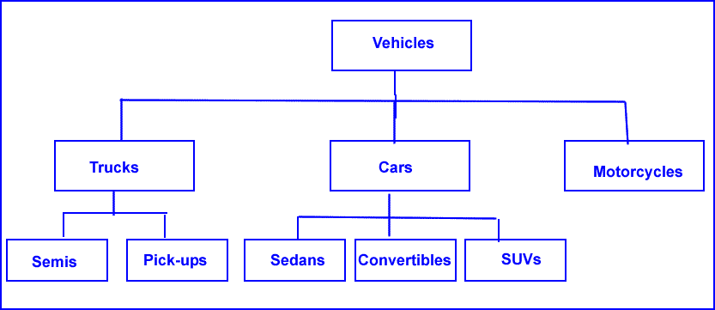
Inheritance
Classifying objects can help explain what they are and how they operate.
For example:
if we know what a car is, we know that all cars have tires, a steering wheel, brakes, doors, and so on
if a friend tells us he has a convertible, he doesn’t have to explain the attributes and functions that it has in common with a car
a convertible inherits these attributes and functions because it is a car
if we have never seen a convertible, the friend would only have to tell us about the special features that distinguish it from any car
This concept of classification and inheritance also works in object-oriented programming.

Slide 21
Inheritance: Extending a Class
Object-oriented languages allow us to create subclasses of an existing class.
The existing class is called the parent or base class.
The subclass is called the child or derived class.
The attributes and methods of the base class automatically become members of the derived class, together with any additional attributes and methods defined specifically for the latter.
We can say that the child class extends the parent class.

Slide 22
Example: A Child Class of the Cube Class
1 Class Cube
2 Declare Protected Side, Volume As Float
3 Public Cube() //create constructor
4 Set Side = 1.0; Set Volume = 1.0
5 End Constructor
6 Public Subprogram SetSide(Float NewSide)
7 Set Side = NewSide
8 End Subprogram
9 Public Subprogram ComputeVolume()
10 Set Volume = Side^3
11 End Subprogram
12 Public Function GetVolume() As Float
13 Set GetVolume = Volume
14 End Function
15 Public Function GetSide() As Float
16 Set GetSide = Side
17 End Function
18 End Class
//Create the child class
19 Class SquareBox Extends Cube
20 Declare Private Height As Float
Public SquareBox() //create constructor
Set Height = 1.0
Set Side = 1.0
Set Volume = 1.0
25 End Constructor
26 Public Subprogram SetHeight(Float NewHeight)
27 Set Height = NewHeight
28 End Subprogram
29 Public Function GetHeight() As Float
30 Set GetHeight = Height
31 End Function
32 Public Subprogram ComputeVolume()
33 Set Volume = Side^2 * Height
34 End Subprogram
35 End Class

Slide 23
Polymorphism
In a hierarchy of classes, often some methods are common to several classes, but their definitions may differ from class to class.
A module might contain definitions of many three-dimensional objects, like cubes, boxes, spheres, or cylinders.
Each of these needs a different formula to compute the volume.
Polymorphism allows for this kind of flexibility.

Slide 24
Example: Polymorphism and Virtual Methods
Imagine a program that is created to provide the payroll department of a certain company with information about employee paychecks.
The program contains a parent class called Worker with members that describe things common to all employees.
It also has several child classes that contain members with information specific to different types of workers (such as truck drivers, clerical staff, etc.).
The Worker parent class, among other things, computes the gross pay of an employee but different types of employees have paychecks calculated in different ways.
The following slides show, in general, how OOP’s property of polymorphism can handle this problem.

Slide 25
Polymorphism and Virtual Methods (continued)
The Worker parent class computes the gross pay of an employee with a method called ComputeGross() which uses the results of two other methods in the class:
ComputeReg() calculates regular pay: hourly rate X hours up to 40
ComputeOT() calculates overtime pay by hours over 40 X 1.5 X hourly rate
ComputeGross() uses the following formula:
Gross = ComputeReg(RegHours) + ComputeOT(OverHours)
Student workers’ overtime is calculated differently:
at 1.75 X hourly rate for hours over 40
The child class, StudentWorker, can use ComputeGross() but must use its own method for overtime pay.
ComputeGross() uses a ComputeOT() method which is in the parent class.
Must tell the parent class that, for StudentWorker objects, it must use the ComputeOT() method from the subclass and not from its own class

Slide 26
Polymorphism and Virtual Methods (continued)
Polymorphism allows us to handle this problem.
Some OOP languages can declare the ComputeOT() method in the Worker class as a virtual method which is only accessed when instructed.
This allows StudentWorker to make use of the ComputeGross() method in the parent class and substitute its own ComputeOT() method for the one defined in the parent class.

Slide 27
11.3 Object-Oriented Program Design and Modeling
OOP design emphasizes determining the objects needed to solve a given problem.
In terms of the program development cycle—problem analysis, program design, program coding, and program testing—it is the analysis phase that differs the most between the two approaches.
To develop an OOP program, the analysis phase entails the following:
Identifying the classes to be used in the program
Determining the attributes needed for the classes
Determining the methods needed for the classes
Determining the relationships among the classes

Slide 28
Modeling Languages
Flowcharts, hierarchy charts, and IPO (Input-Process-Output charts) are used to help design programs.
As programs get larger the models also get larger and more complicated.
Software developers use modeling languages to help design large programs.
An object modeling language is a standardized set of symbols that includes ways to arrange these symbols to model parts of an object-oriented software design or system design.

Slide 29
Unified Modeling Language (UML)
Unified Modeling Language (UML)
a non-proprietary, general-purpose modeling language
accepted in 2000 by International Organization for Standardization (ISO)
is an industry standard for describing software-intensive systems
UML 2.4.1, the current version, was published in 2011 by the Object Management Group (OMG)
The term Unified Modeling Language resulted from the combined efforts of 3 men:
Ivar Jacobson, James Rumbaugh, and Grady Booch, nicknamed the Three Amigos
UML can be used to create an abstract model of a system
UML diagrams represent three different views of a system model

Slide 30
Three Views of a System Model
The functional requirements view
emphasizes the requirements of the system from user’s viewpoint
presents a graphical overview of what a system does, in terms of actions and goals, and any dependencies between them
The static structural view
emphasizes the static structure of the system using objects, attributes, operations, and relationships
includes diagrams that allow the designer to see the structure of a program by showing the classes, their attributes, and the relationships between the classes
also includes diagrams that show the internal structure of a class and the relationships that this structure makes possible
The dynamic behavior view
emphasizes the dynamic behavior of the system
shows collaborations among objects and changes to the internal states of objects
dynamic characteristics of a system are the ways the system behaves in response to certain events or actions

Slide 31
Categories of UML Diagrams
There are 3 significant categories of diagrams:
Structure diagrams emphasize what things must be in the system being modeled.
Behavior diagrams emphasize what must happen in the system being modeled.
Interaction diagrams are a subset of behavior diagrams; they emphasize the flow of control and data among the things in the system being modeled.

Slide 32
Why Use UML?
In a well-designed OOP program, classes and subclasses have many uses.
Creating software is a matter of writing enormous amounts of code
But the code can reuse many of the same classes, subclasses, and objects in different ways
UML helps the designers:
keep track of what they are doing
what has been done
helps them devise ways to increase functionality and improve the program through time

Slide 33
11.4 Graphical User Interfaces and Event-Driven Programming
One important application of object-oriented programming (OOP) is to create programs that use a graphical user interface (GUI).
A GUI includes windows that contain components such as:
Menus
Buttons
Boxes
These allow users to make choices and issue commands.

Slide 34
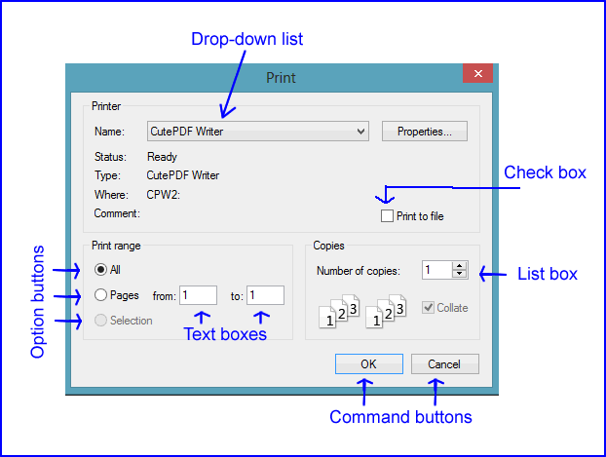
Window Components

Slide 35
Creating GUI Objects in a Program
In some programming languages, GUI objects are created in the same way as any other objects, as instances of the class to which they belong.
In other programming languages, GUI objects are selected from a menu or toolbar and drawn on the screen.
Each window and window component (command button, text box, and so forth) in a GUI has a set of attributes (or properties), such as name, position, and size.

Slide 36
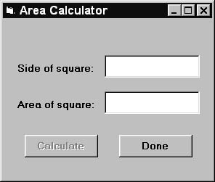
Some Properties of a window
name (by which it’s known in the program)
height and width (usually in pixels, the tiny dots that make up the screen image)
title (“Area Calculator” shown on right)
title font (the typeface and size of the window title)
visible (true or false)—whether or not the window appears on the screen

Slide 37
Some Properties of command and option buttons
Some command button properties:
name (by which it’s known in the program)
caption (”Done” or “Calculate” shown in figure)
position (distance, in pixels, from the left and top edges of window)
enabled (true or false)—whether the button is active or inactive
Some option button properties:
name (by which it’s known in the program)
caption (“All”, “Pages”, or “Selection” shown in window slide)
enabled (true or false)—whether the button is active or inactive
value (true or false)—whether or not the option button has a bullet

Slide 38
Setting Properties
Most GUI properties have default values
automatically used unless new ones are assigned
to change these default values, use assignment statements
Example:
In the Area Calculator window, if the name of the window is MainWindow, then use statements:
Set MainWindow.title = “Area Calculator”
Set MainWindow.height = 100
to specify that the title of the window is “Area Calculator” and the height is 100 pixels.
If the name of the right command button is QuitButton, then the following statements:
Set QuitButton.caption = “Done”
Set QuitButton.enabled = false
label the button as “Done” and cause it to be grayed out when the window is opened.

Slide 39
Event-Driven Programming: Handling Events
In many programs the actions of the user (like clicking the mouse) or system-related circumstances (like the state of a timer) determine the flow of execution.
These actions are called events and the resulting program is said to be event-driven.
windows and the components contained within them are objects that have various attributes.
A set of events and methods, called event-handlers or event procedures are associated with each object

Slide 40
Some methods for windows and Components
command button
Click(): executes automatically when the button is clicked
text box
Click(): executes automatically when the box is clicked
Change: executes automatically when the text within the box is changed
option button
Click(): executes automatically when the button is clicked
window
Open(): opens (displays) the window
StartUp(): a programmer-written procedure that executes automatically when the window is opened
Close(): this closes the window (removes it from the screen)

Slide 41
An Event-Driven GUI Calculator
1 Window
2 name = MainWindow
3 title = “Area Calculator”
4 Upper Label
5 text = “Side of square”
6 Lower Label
7 text = “Area of square”
8 Upper Text Box
9 name = InputBox
10 text = “ ”
11 Subprogram InputBox.Click()
12 Set InputBox.text = “”
13 Set OutputBox.text = “”
14 Set CalculateButton.enabled = false
15 End Subprogram
16 Subprogram InputBox.Change()
17 Set CalculateButton.enabled = true
18 End Subprogram
19 Lower Text Box
20 name = OutputBox
21 text = “”
22 Left Command Button
23 name = CalculateButton
24 caption = “Calculate”
25 enabled = false
26 Subprogram CalculateButton.Click()
27 Set OutputBox.text = Val(InputBox.text)^2
28 End Subprogram
29 Right Command Button
30 name = DoneButton
31 caption = “Done”
32 Subprogram DoneButton.Click()
33 Call MainWindow.Close
34 End Program
35 End Subprogram

Slide 42
Event-Driven Program Design: Analysis Phase
Identify windows needed in the program.
Determine relationships among the windows.
For example, which window can open another so that the latter appears on the screen.
Such relationships can be pictured in a flow diagram (see next slide) where an arrow pointing from one window to another means that the first can open or reactivate the second. A double arrow, pointing in both directions means that either window can open or reactivate the other.
For each window do the following:
Determine the components needed for that window
Draw a rough sketch of the resulting window
Determine the properties and methods needed for the window and each of its components

Slide 43
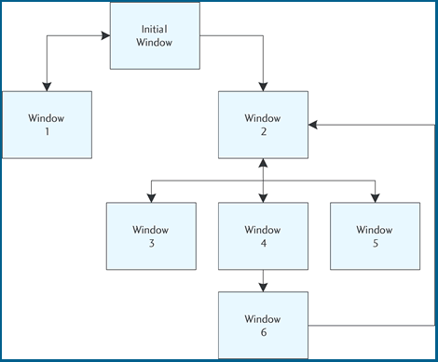
Flow Diagram for a GUI Program

